Slide 1
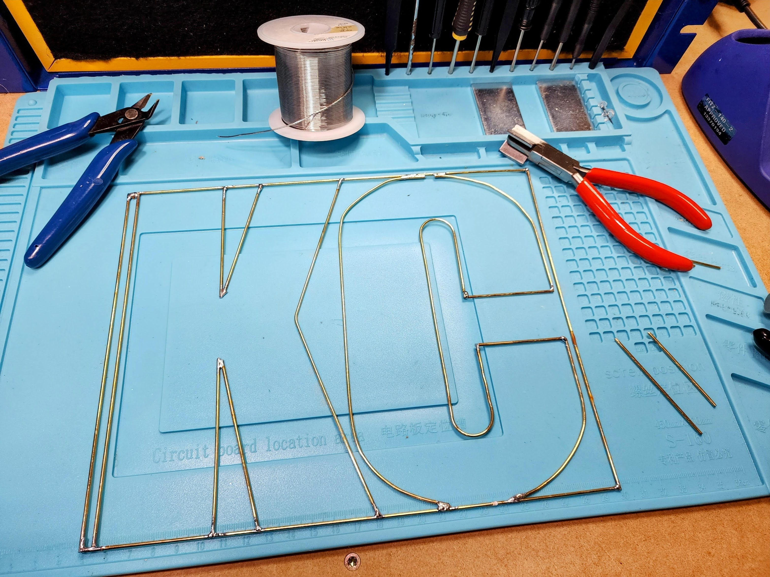
Guidelines
This will be framed do try and keep the components flat as much as possible and not raised above the brass rods
Fill in the inside of the ‘KC” only please
Be creative!
Community Solder Art Project

